Slide 1


Chapter 15
External Methods

Slide 2

A Look At External Storage
External storage
  Exists beyond the execution period of a program
  Generally, there is more external storage than internal memory
Sequential access file
  To access the data, you must advance the file window beyond all the intervening data
  Resembles a linked list
Random access file
  Data can be accessed at a given position directly
  Resembles an array
  Essential for external tables

Slide 3
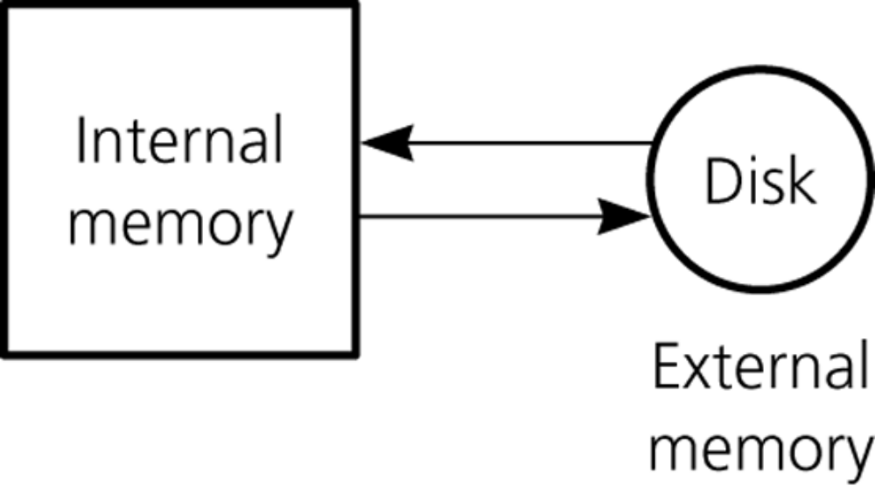
A Look At External Storage
Figure 15-1
Internal and external memory

Slide 4
A Look At External Storage
A file consists of data records
  Records are organized into one or more blocks
    The number of records in a block is a function of the size of the records
Random access file
  All input and output is at the block level
Buffer
  A location that temporarily stores data as it makes its way from one process or location to another
  Used while transferring data between internal and external memory

Slide 5
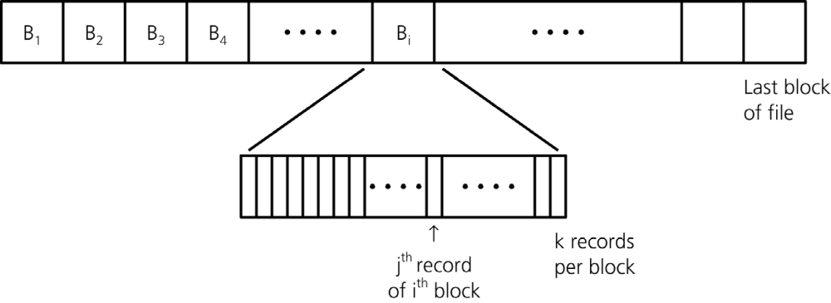
A Look At External Storage
Figure 15-2
A file partitioned into blocks of records

Slide 6
A Look At External Storage
Once the system has read a block into the buffer buf, the program can process the records in the block
If the program modifies the records in buf, it must write buf back out to dataFile
The number of block accesses should be reduced as much as possible
  Block access time is the dominant factor when considering an algorithm’s efficiency

Slide 7
Sorting Data in An External File
The challenge with sorting data in an external file
  An external file is too large to fit into internal memory all at once
  Sorting algorithms presented earlier in the book assume that all the data to be sorted is available at one time in internal memory
Solution
  Use a modified version of mergesort

Slide 8
Sorting Data in An External File
External mergesort
  Phase 1
    Read a block from F (data file to be sorted) into internal memory, sort its records by using an internal sort, and write the sorted block out to F₁ (a work file) before reading the next block from F
    Repeat the above step for all the blocks of F
  Phase 2 (a sequence of merge steps)
    Each merge step
      Merges pairs of sorted runs to form larger sorted runs
      Doubles the number of blocks in each sorted run
      Halves the total number of sorted runs
    At the end
      F₁ will contain all the records of the original file in sorted order

Slide 9
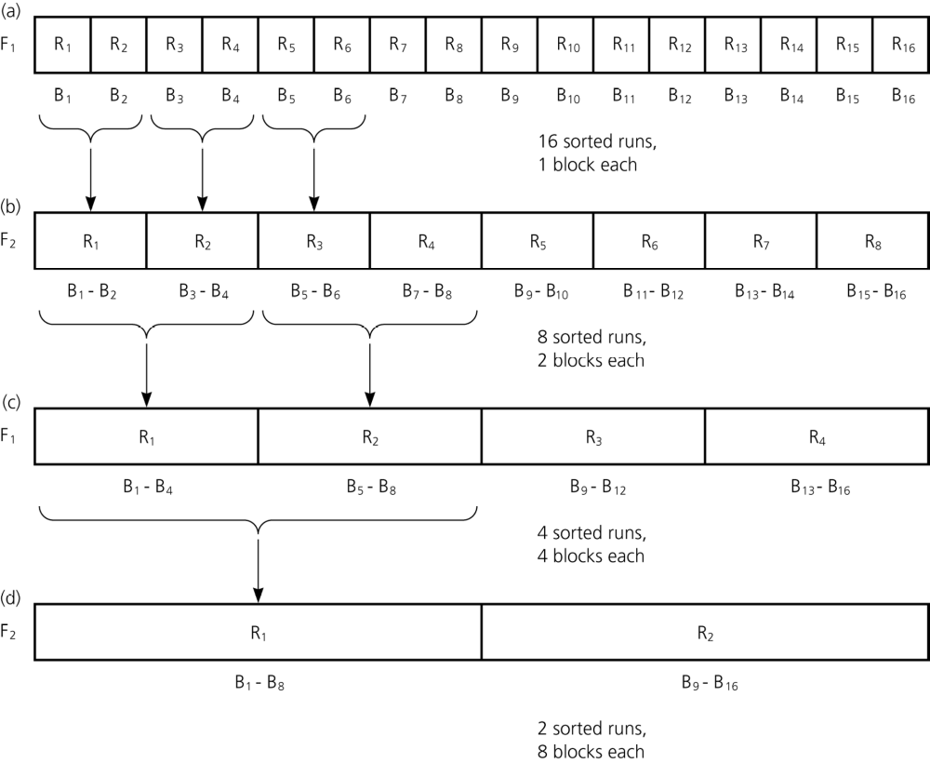
Sorting Data in An External File
Figure 15-3
a) 16 sorted runs, 1 block each, in file F₁; b) 8 sorted runs, 2 blocks each, in file F₂; c) 4 sorted runs, 4 blocks each, in file F₁; d) 2 sorted runs, 8 blocks each, in file F₂

Slide 10
External Tables
External implementation of the ADT table
  Records are stored in search-key order
    The file can be traversed in sorted order
    Main advantage
      A binary search can be used to locate the block that contains a given search key
    Main disadvantage
      tableInsert and tableDelete operations can require many costly block accesses due to the need to shift records

Slide 11
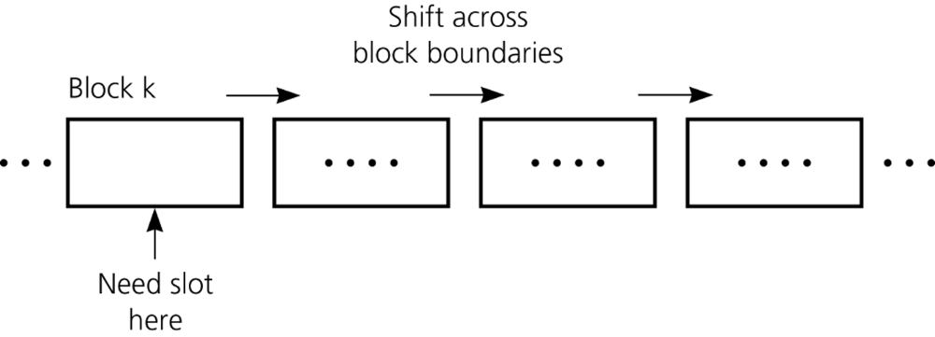
External Tables
Figure 15-5
Shifting across block boundaries

Slide 12
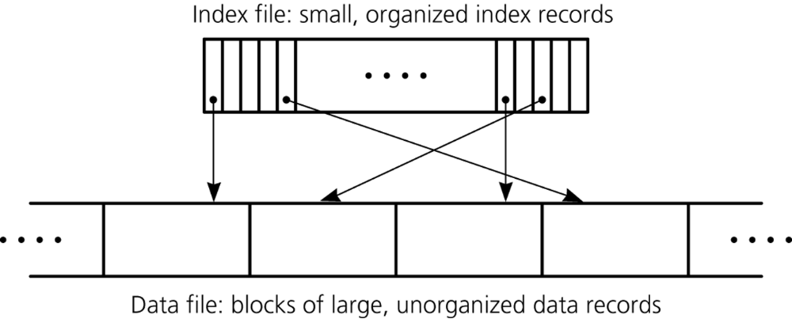
Indexing An External File
An index (or index file)
  Used to locate items in an external data file
  Contains an index record for each record in the data file
Figure 15-6
A data file with an index

Slide 13
Indexing An External File
An index record has two parts
  A key contains the same value as the search key of its corresponding record in the data file
  A pointer shows the number of the block in the data file that contains the data record
Advantages of an index file
  An index file can often be manipulated with fewer block accesses than would be needed to manipulate the data file
  Data records do not need to be shifted during insertions and deletions
  Allows multiple indexing

Slide 14
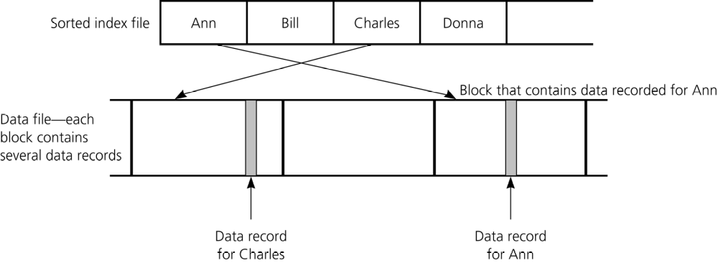
Indexing An External File
A simple scheme for organizing the index file
  Store index records sequentially
Figure 15-7
A data file with a sorted index file

Slide 15
Indexing An External File
Storing index records sequentially
  tableRetrieve operation
    Can be performed by using a binary search on the index file
  tableInsert and tableDelete operations
    Require only the shifting of index records, not data records
      Benefits of shifting index records rather than data records
        Reduction in the maximum number of block accesses required
        Reduction in the time requirement for a single shift
  More efficient than having a sorted data file
  Not as efficient as using hashing or search trees to organize the index file

Slide 16
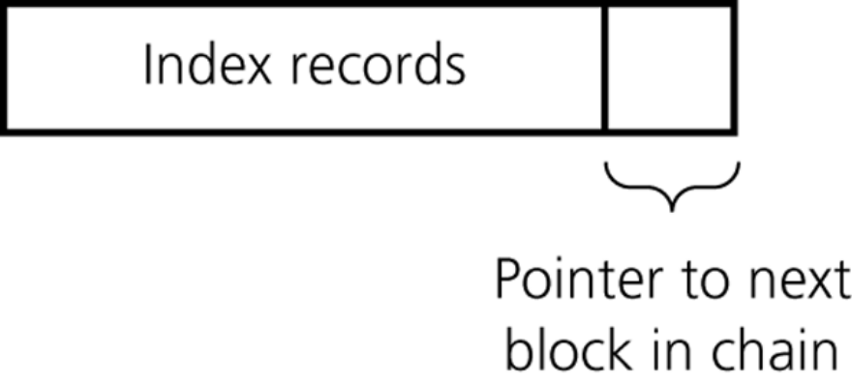
External Hashing
The index file, not the data file, is hashed
  Each entry table[i] is associated with a linked list of blocks of the index file
  Each block of table[i]’s linked list contains index records whose keys hash into location i
  To form the linked list, space must be reserved in each block for a block pointer
    A block pointer is the integer block number of the next block in the chain
Figure 15-9
A single block with a pointer

Slide 17
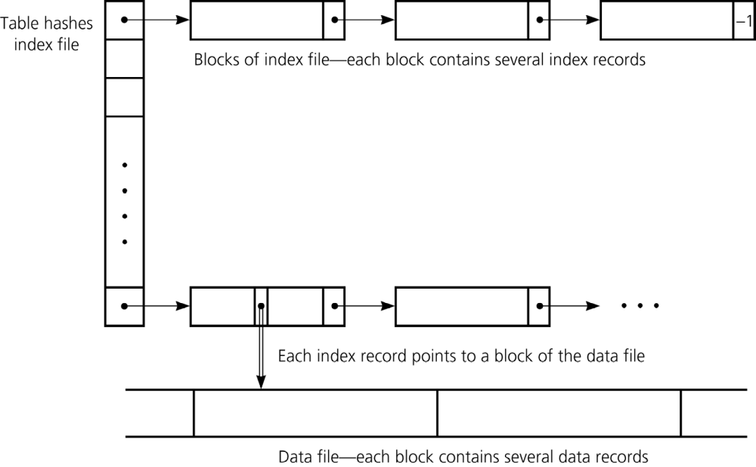
External Hashing
Figure 15-8
A hashed index file

Slide 18
External Hashing
Retrieval under external hashing of an index file
  Apply the hash function to the search key
  Find the first block in the chain of index blocks (these blocks contain index records that hash into location i)
  Search for the block with the desired index record
  Retrieve the data item, if present

Slide 19
External Hashing
Insertion under external hashing of an index file
  Step 1: Insert the data record into the data file
    New record can be inserted anywhere in the data file
  Step 2: Insert a corresponding index record into the index file
    For an index record that has key value searchKey and reference value p
      Apply the hash function to searchKey, letting
        i = h(searchKey)
      Insert the index record < searchKey, p> into the chain of blocks that the entry table[i] points to

Slide 20
External Hashing
Deletion under external hashing of an index file
  To delete the data record whose search key is searchKey
    Step 1: Search the index file for the corresponding index record
      Apply the hash function to searchKey, letting
        i = hash(searchKey)
      Search the chain of index blocks pointed to by the entry table[i] for an index record whose key value equals searchKey
      If an index record < searchKey, p> is found
        Note the block number p
        Delete the index record

Slide 21
External Hashing
Deletion under external hashing of an index file
  To delete the data record whose search key is searchKey
  Step 2: Delete the data record from the data file
    Access the block p
    Search the block for the record
    Delete the record
    Write the block back to the file

Slide 22
External Hashing
External hashing implementation
  Should be chosen for performing the following operations on a large external table
    tableRetrieve
    tableInsert
    tableDelete
  Not practical for some operations, such as
    Sorted traversal
    Retrieval of the smallest or largest item
    Range queries that require ordered data

Slide 23
Please open file carrano_ppt15_B.ppt
to continue viewing chapter 15.

